Slide 1

SP3-Mobyland
Group 5
Gabriel
Sze Ting
Reagan
Winston

Slide 2
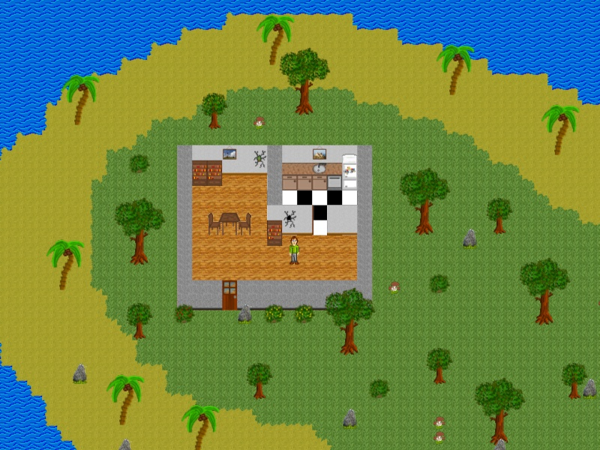
Game overview and synopsis
A top down survival game, craft items and survive to and defeat the boss to escape on the trapped island and win the game
Notes:
Our game over

Slide 3

Trailer

Slide 4
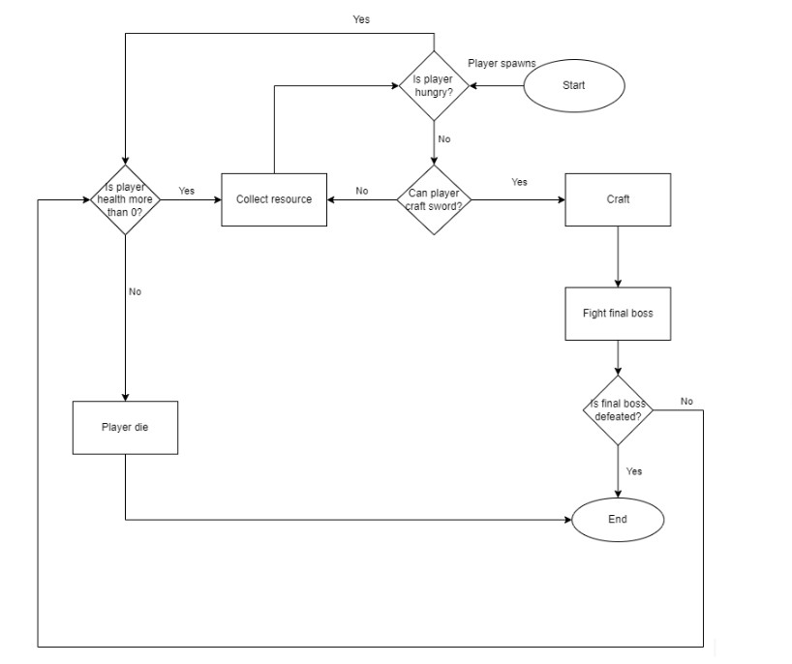
Core game flow

Slide 5
MDA
Mechanics | Dynamics | Aesthetics
Health points(HP) Stamina Hunger Dodge Forage Food Melee Attack Projectile Crafting At least one boss fight in the dungeon | Collect resources Craft essentials Hunt animals for food Defend oneself during combat Explore the map, island and dungeon Conquer the dungeon | Submission Exploration Challenge

Slide 6
Player status
Player Health | Keep your health above 0% to avoid dying
Hunger | Starvation can kill, food is a valuable resource
Stamina | Required to dodge (consumes 30%) Recharges overtime

Slide 7
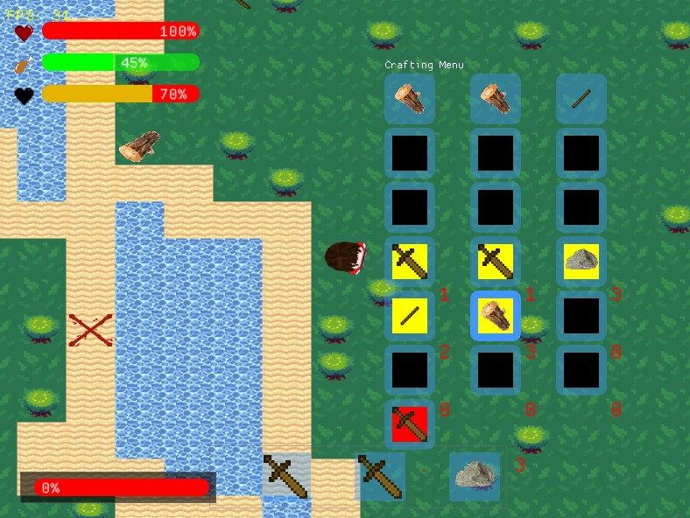
Crafting
Press Q to go toggle crafting menu
Crafting slot, drag items from inventory slot below to here
Output slot, results of your arrangement

Slide 8
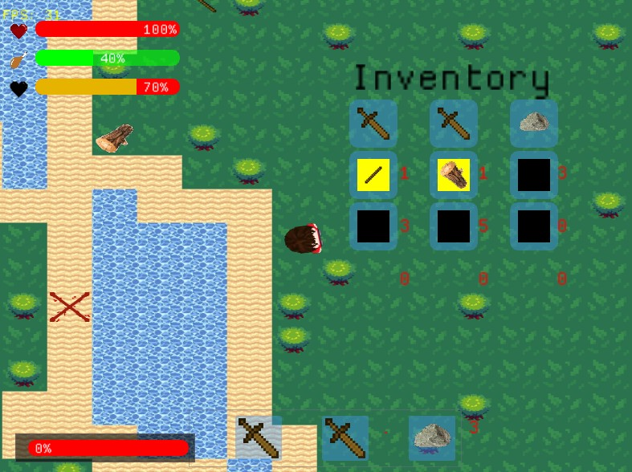
Inventory
Press I to go toggle inventory menu
Whatever you collected will be here, for non stackable and stackable items. Quantity is displayed beside

Slide 9
Inventory
Press I to go toggle inventory menu
To use tools, put them in hotbar and click on the section
To place campfire or eat food, press wither 1,2 or 3 to use the item inside

Slide 10


Recipes(Campfire)

Slide 11
Recipes(Wood)

Slide 12
Recipes(Sword)

Slide 13
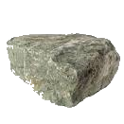
Recipes(Shovel)

Slide 14
Enemies
Octopus | Don’t get in contact with it or get damaged
Spider | Can shoot projectiles
Skeleton | Has both ranged and melee attacks
Chicken | Categorised as enemy, but is passive regardless
Bob | Final boss, with both ranged and melee attacks
All enemies | Max HP increases every 200 secs

Slide 15

Octopus
Health: 20
Contact damage: 10
Projectile damage: -
AI: Chases player regardless of distance.
Attack has a 1 sec cooldown before it
can attack again.
Drops: chance of shiv and dagger blade
Special enhancement: Every 5 kills increases player’s attack range

Slide 16
Spider
Health: 30
Contact damage: -
Projectile damage: 20
AI: Is not aggressive so it does not
chase the player. When player is within
the range of its attack, it will shoot webs.
If player is too close, it will run.
Drops: chance of iron hilt and cleaver blade
Special enhancement: Every 3 kills, player’s attack will gain lifesteal

Slide 17
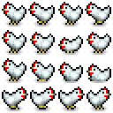
Chicken
Health: 20
Contact damage: -
Projectile damage: -
AI: Passive mob which wanders around in randomised
directions, pausing occasionally. Runs away from player
when it is low health.
Drops: raw chicken meat
Special enhancement: Every 5 kills increases player’s attack speed

Slide 18

Skeleton (Miniboss)
Health: 100
Contact damage: 10
Projectile damage: 30
AI: Is always sleeping unless player wakes
it up. Chases the player when awake. When
player is within the radius of its ranged
attacks, it will shoot bones. When player is too close, it will do a
melee attack.
Drops: chance of platinum hilt and katana blade
Special enhancement: Every 1 kill increase player’s damage

Slide 19

Bob
Health: 300
Contact damage: 30
Projectile damage: 10
AI: Chases player regardless of distance.
Moves in random direction when within radius.
Does 3 range attacks before biting the player.
Drops: -
Special enhancement: -

Slide 20
Items
Base | Sticks and wood, things can can be gathered by hand
Tools | Shovel, use to dig up items
Build | Campfire, place it on the ground to cook food
Weapons | Sword, craftable and upgradable using hilt and blade
Food | Can only eat when cooked near campfire, regenerates both hunger and health
Mob drops | Raw meat, must be cooked Shivs, the only projectile you’ll get Hilts, use to craft and upgrade swords

Slide 21


Weapons
Sword
Shiv
-Made out of a hilt and blade
-Can be crafted and upgraded
-Click to slash, damaging enemies in a conical radius according to cursor position
-Thrown by holding right click to charge
-Dropped by mobs
-Does 20 damage
-Projectile

Slide 22



Sword - Hilt
Determines the potency of stat upgrades to the sword
Sharp: Increases damage (increases every skeleton killed)
Wide: Increases range (increases every 5 octopuses killed)
Ravenous: Increases lifesteal (increases every 3 spiders killed)
Light: Increase attack speed (increases every 5 chickens killed)
Wooden hilt | 1.0x multiplier
Iron Hilt | 1.5x multiplier
Platinum Hilt | 2x multiplier

Slide 23
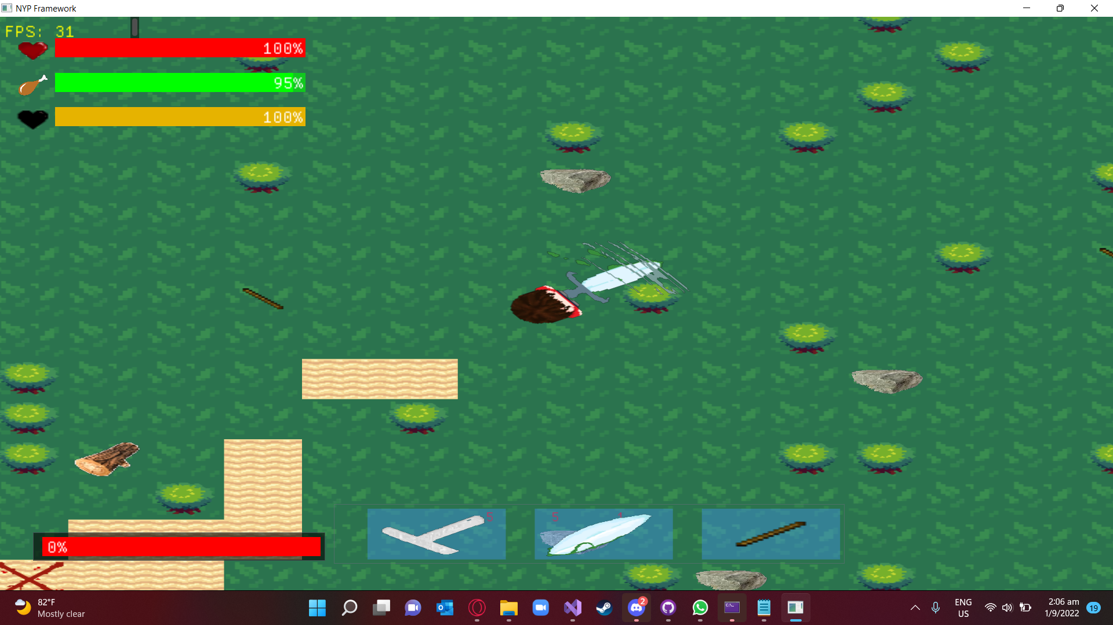
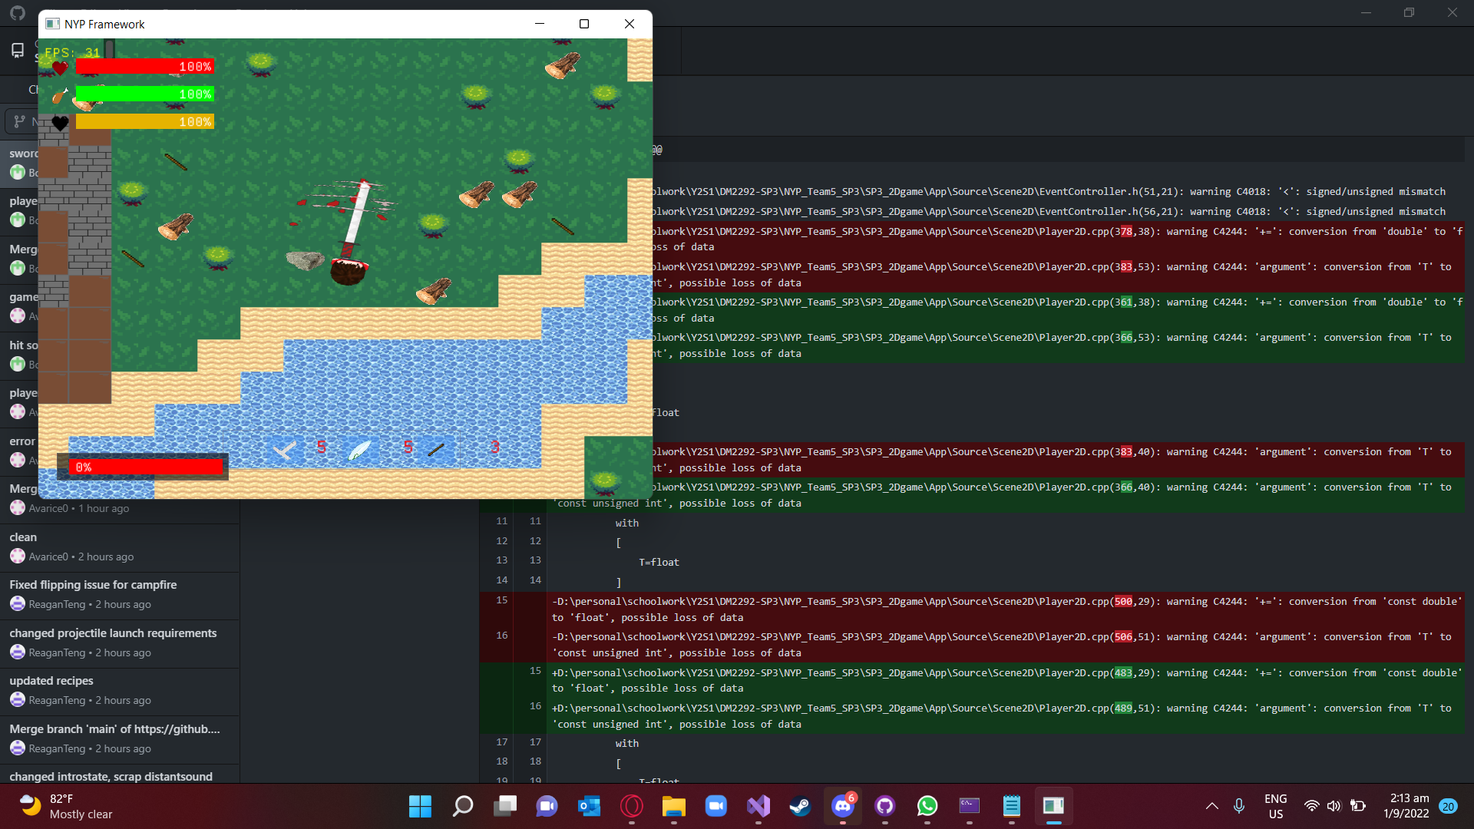
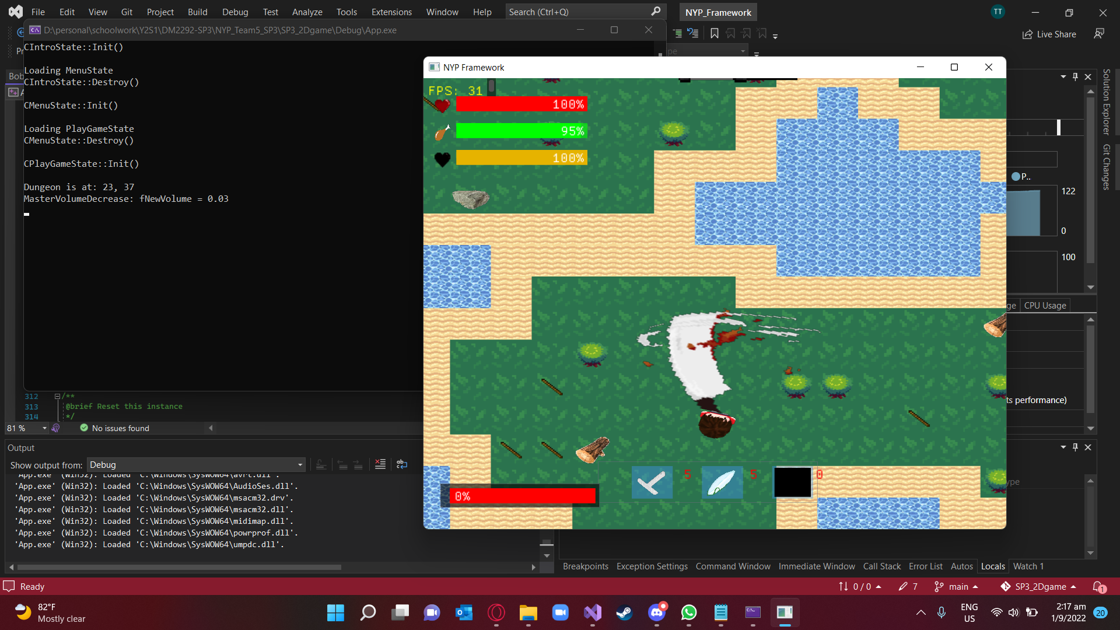
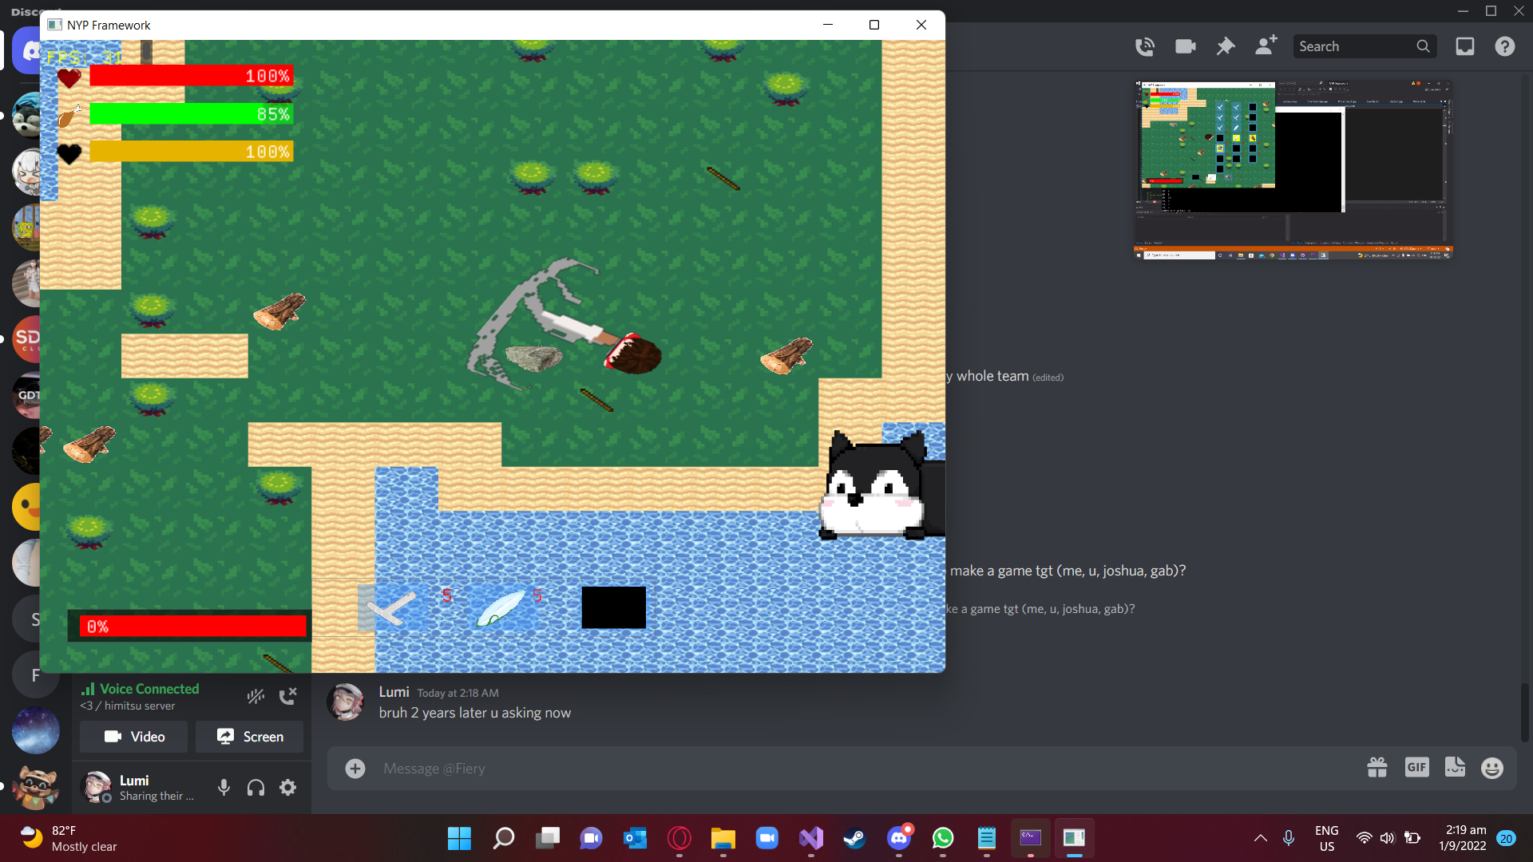
Sword - Blade
Comes with different base stats and animations
Rusty Blade | Low base stats, balanced
Cleaver | High damage and range, low attack speed Applies burn: high DOT
Dagger | High attack speed, low range and damage Applies poison: low DOT, decreases target’s movement speed and damage
Katana | Good and balanced stats Applies bleeding: medium DOT, reduces target’s damage

Slide 24
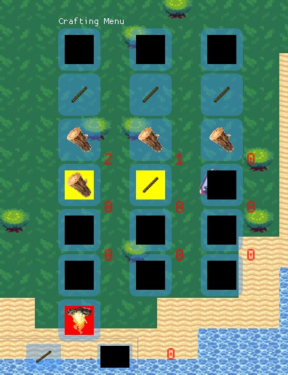
Cooking
Crafting campfire

Slide 25
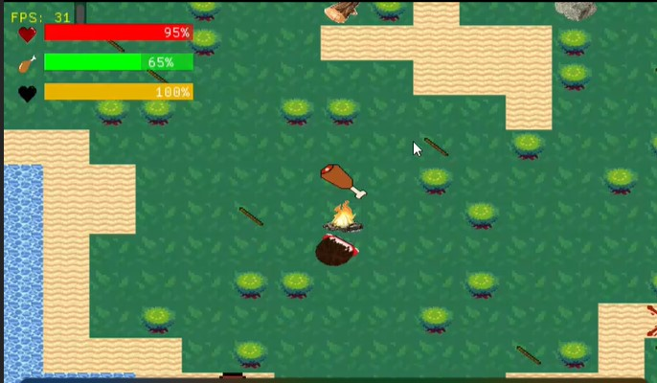
Cooking
Press 1 2 or 3 depending on where you food is in hotbar to cook food, but not before placing the campfire down with the same controls. Wait 10 seconds

Slide 26
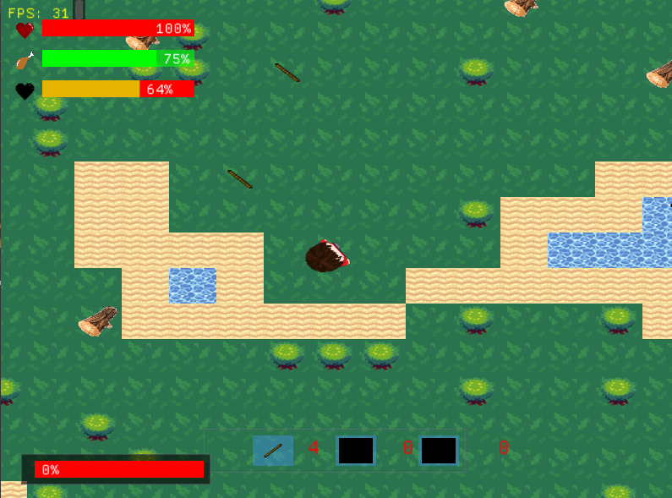
Camera
-Centralised on player
-Restricted at map borders
-Camera shifts slightly toward the cursor position

Slide 27
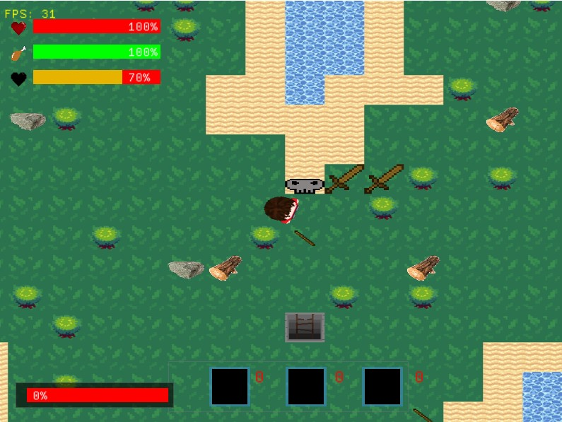
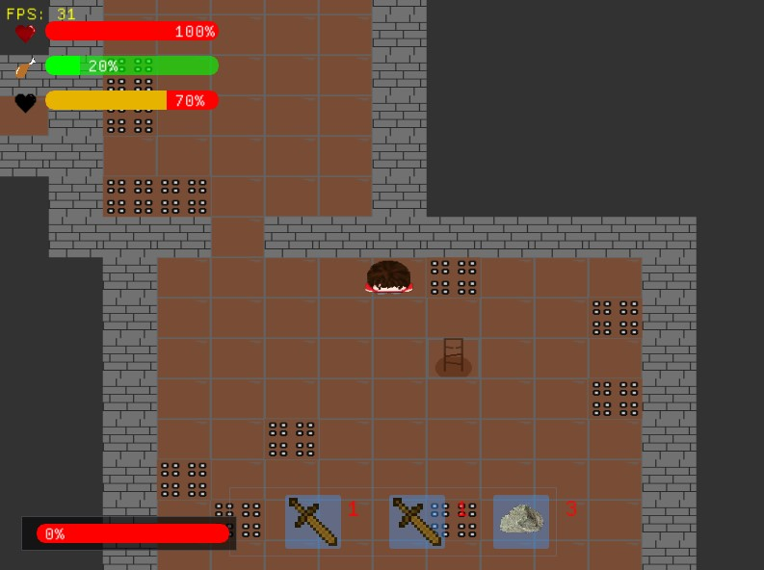
Dungeon
Press E while standing at ladder to go into dungeon, or go out

Slide 28
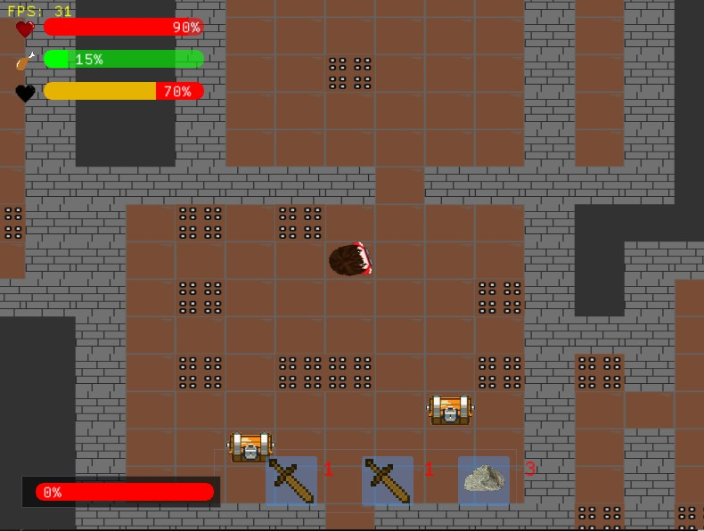
Dungeon
Dungeon treasures

Slide 29
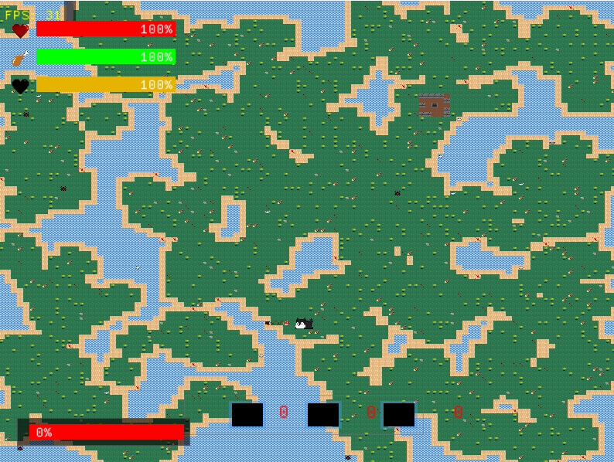
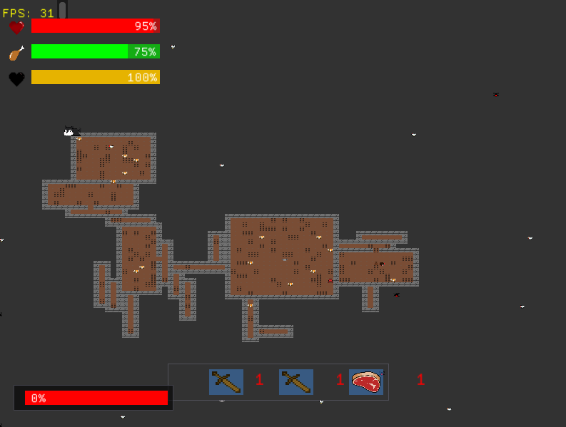
Map Generation
Islands
Large landmasses
Smooth edges
Circular and natural curves
Has some level of complexity
Ie ponds, trees
Use of cellular automata
Dungeon
Rooms
Corridors
Method to enter and leave
Items
Treasure, Spikes
Use of Random Room Placement

Slide 30
Specific roles
Sze Ting
Gabriel
Framework-Camera
Player
Combat
Enemy spawn
Enemy movement/attack
Enemy AI
Enemy drops
Enemy sound
Winston
Reagan
Map generation
Backend/Logic
Projectiles
UI
Inventory
Sounds

Slide 31
Task allocation
 | Winston | Sze Ting | Reagan | Gabriel
GDD | 25% | 25% | 25% | 25%
Player | 10% | 80% |  | 10%
Enemies |  |  |  | 100%
Combat | 15% | 85%
Crafting | 20% |  | 80%
Inventory |  |  | 100%
Sound |  | 20% | 80%
Environment | 100%
Camera |  | 100%
Loot | 30% |  | 40% | 30%

